Slide 1
Training Program 2026 - FNA
1
2026

Slide 2
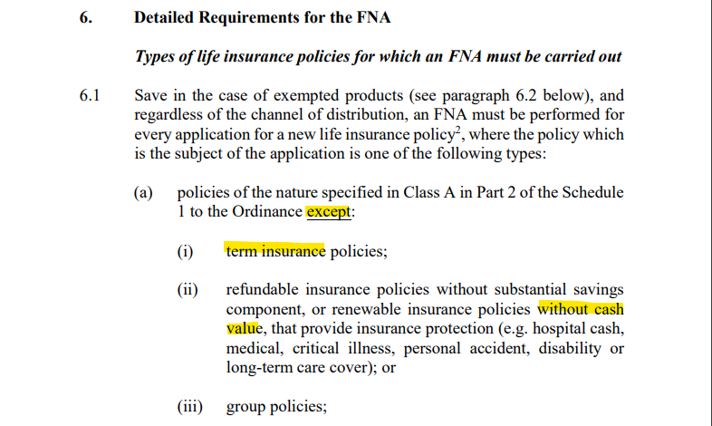
Background
Refer to GL30:
(https://www.ia.org.hk/en/legislative_framework/files/GL30_English.pdf)

Slide 3
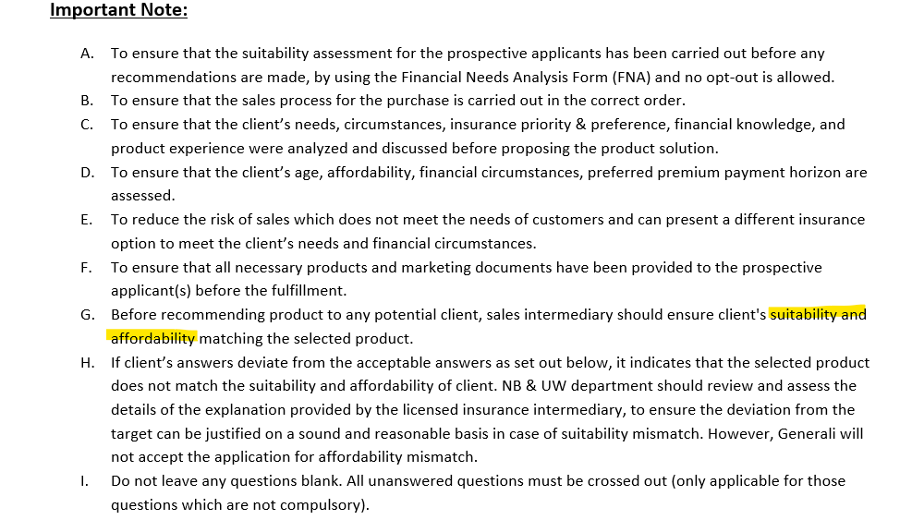
Background

Slide 4
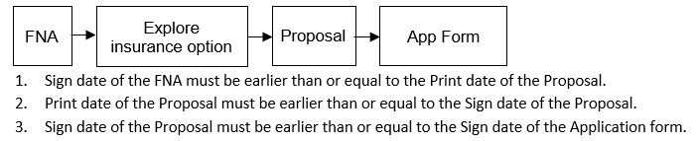
Flow of solicitation of non-ILAS Policies*
*Non-ILAS product means Non-Investment-Linked Assurance Scheme

Slide 5
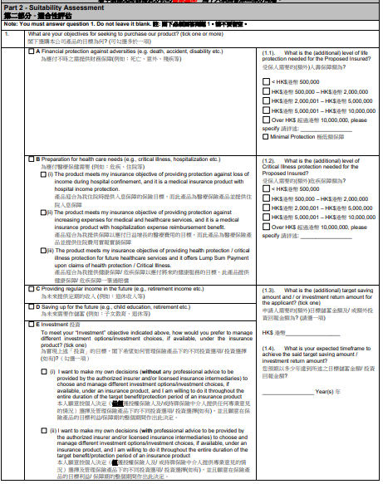

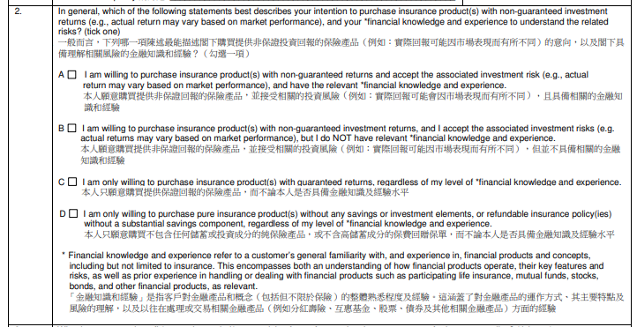
Suitability Assessment
Product Mapping Table:
G:\Retail\Common Folder (with OPS)\Product Mapping Table

Slide 6
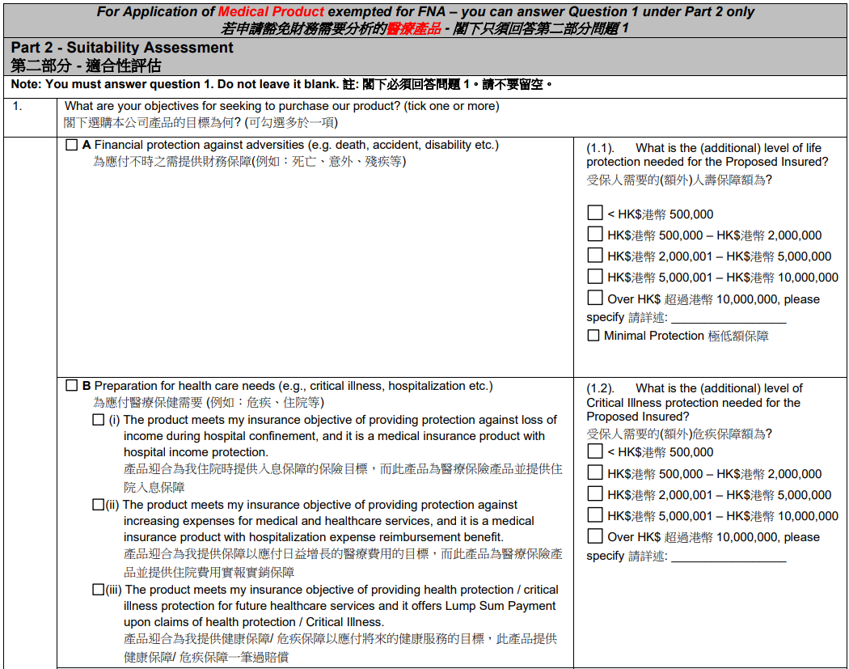
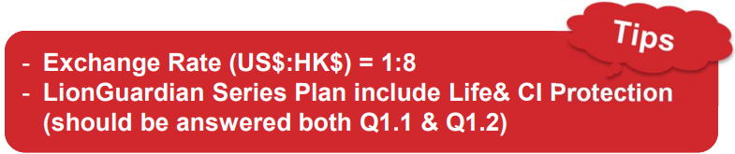
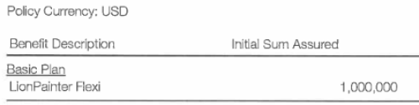
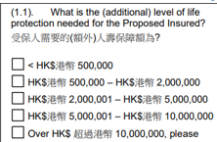
Suitability Assessment
Additional level of Life or Critical Illness protection needs:
The sum assured applying for Life/CI Product must be within the range of 50% - 120% of the client’s answer here
For Lion Patron, need Sum Assured x 2.3 for this answer
This option is applicable to Saving or Annuity Plans (e.g. LionHarvest Prime, LionTycoon Beyond 2, LionAchiever Elite, Promise Pro, LionPrima, Emerald & Pearl)
Example:
USD 1,000,000 x 8 = HKD 8,000,000
Option 1: HKD 8,000,000 / 50% = HKD 16,000,000
Option 2: HKD 8,000,000 / 120% = HKD 6,666,666
√
Either one
√

Slide 7
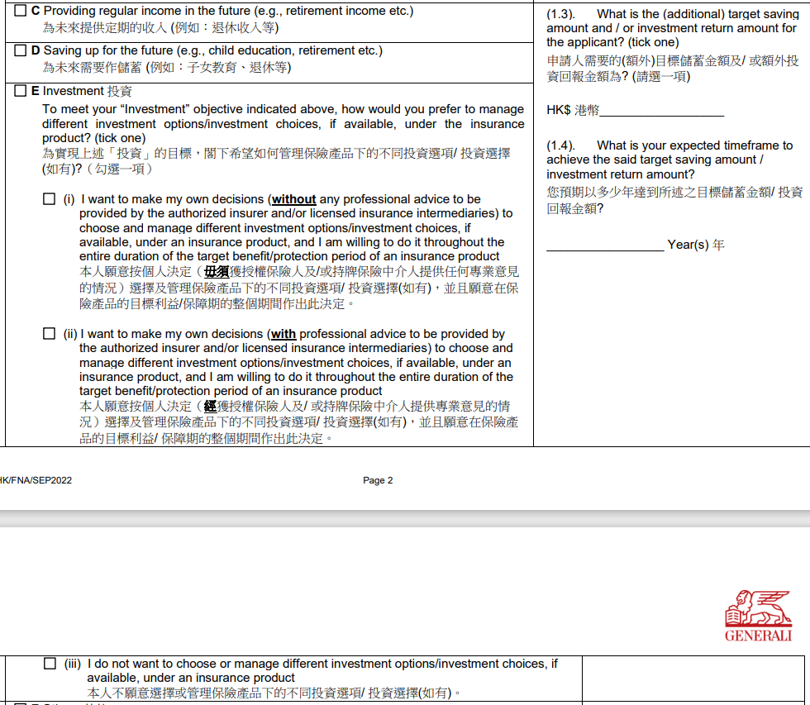

Suitability Assessment
For ILAS product only
Not applicable
This option is applicable to Saving or Annuity Plans (e.g. LionHarvest Prime, LionTycoon Beyond 2, LionAchiever Elite, Promise Pro, LionPrima, Emerald & Pearl)

Slide 8
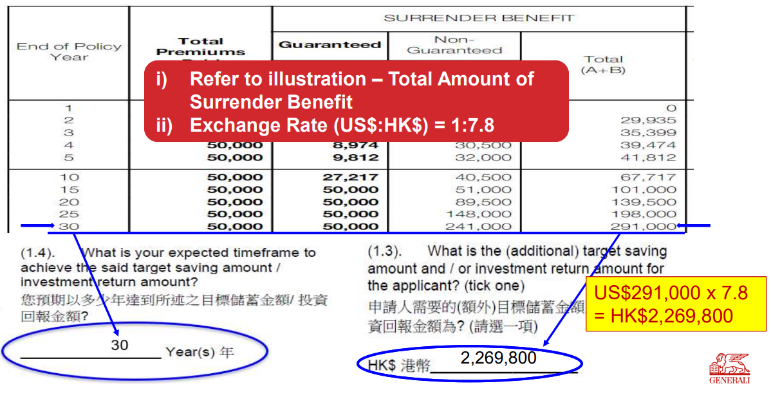
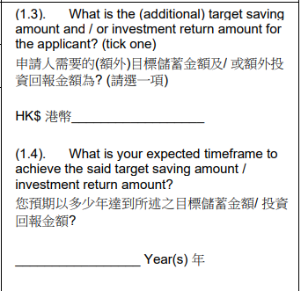
Suitability Assessment
2,156,310
2,405,988
30
30
Pass or Fail ?

Slide 9
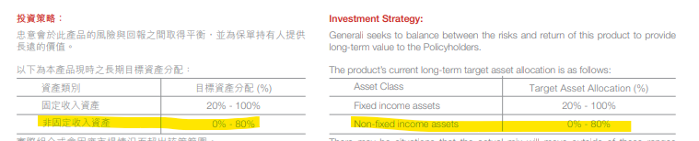
Suitability Assessment
Special Handling for specific brokers:
1.CITIC 2. Fubon^ 3. CMB* 4. OnePlatform 5. AMG
* Supplementary Form is required for product mapping
^ Fubon’s Supplementary Form will be provided for product mapping until Aug 2026
Key points:
Financial Knowledge AND Experience
Target Asset Allocation on non-fixed income

Slide 10
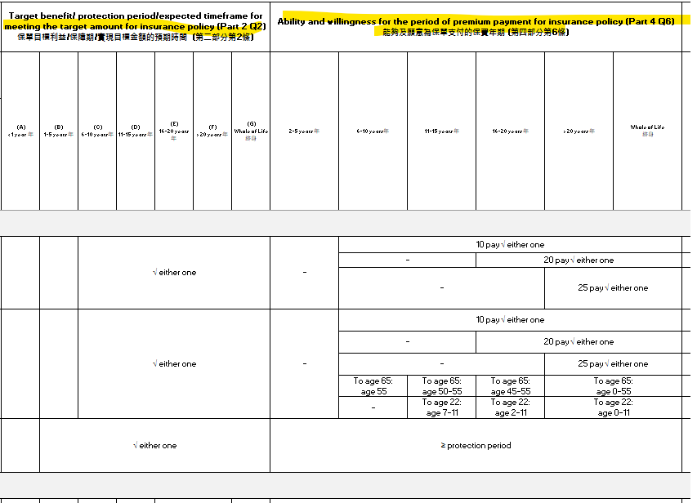
Suitability Assessment

Slide 11
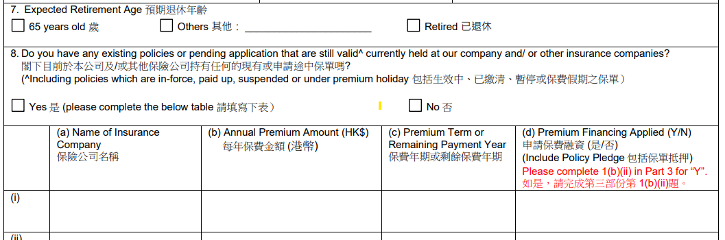
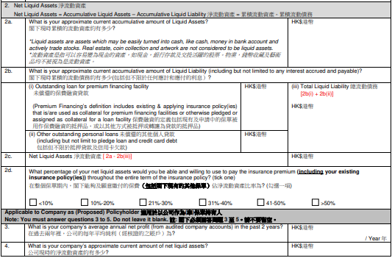
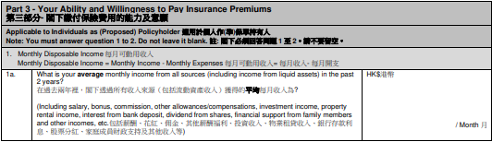
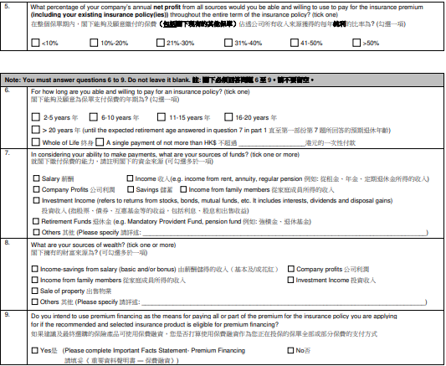
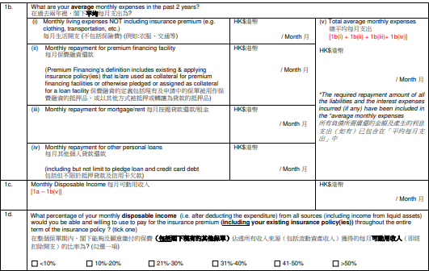
Affordability Assessment

Slide 12
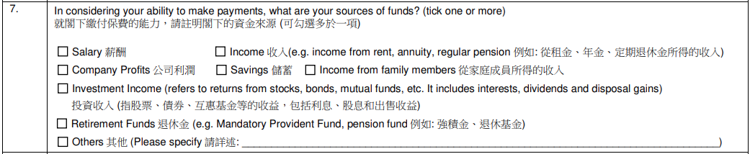
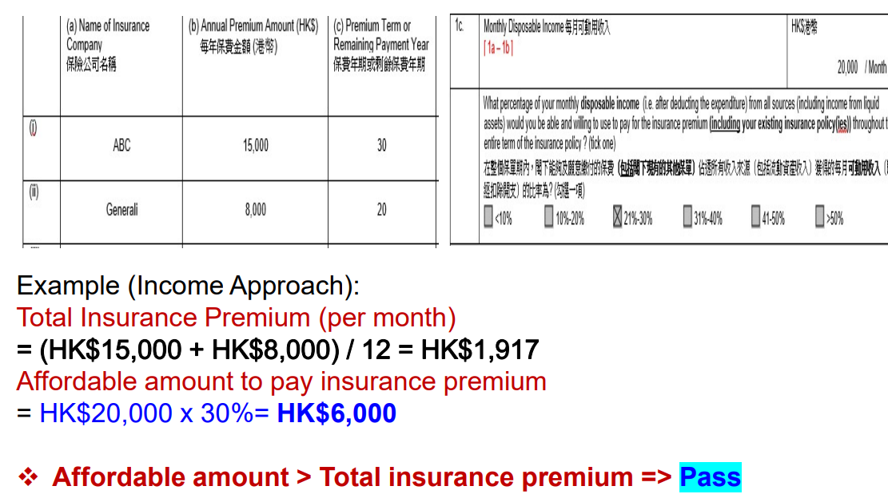
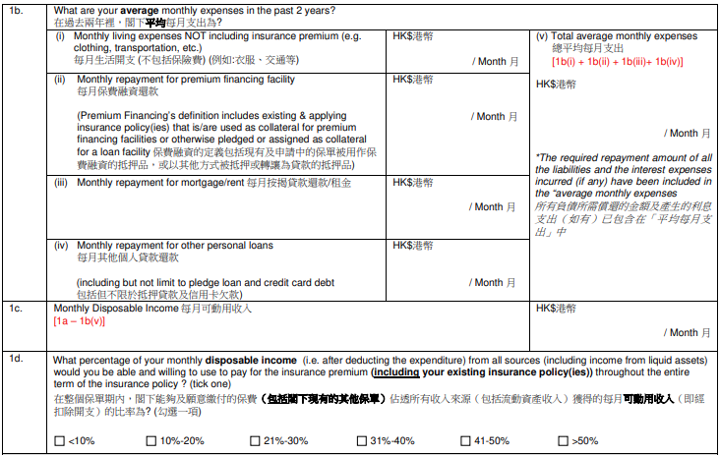
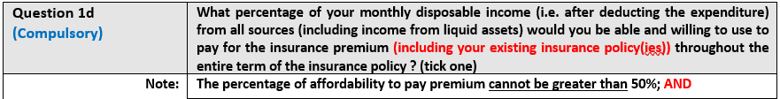
Affordability Assessment (Income Approach)
√
√
√
√
√
Applying

Slide 13
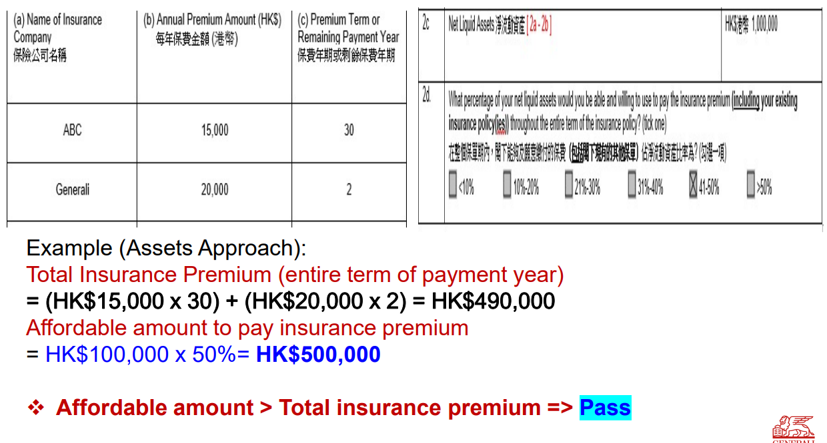
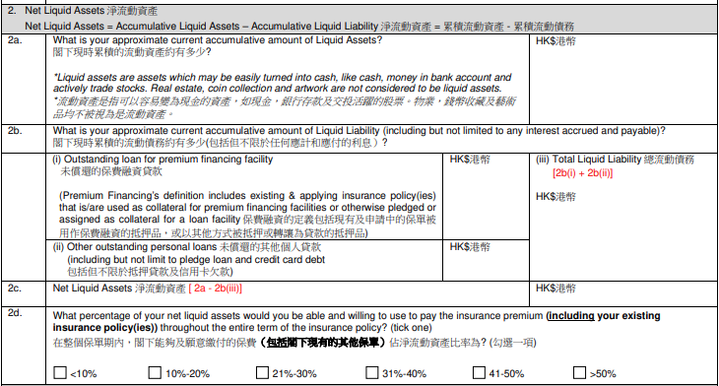
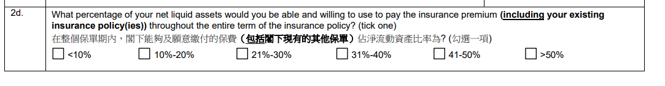

Affordability Assessment (Assets Approach)
√
√
√
Applying
HK$1,000,000 x 50% = HK$ 500,000

Slide 14
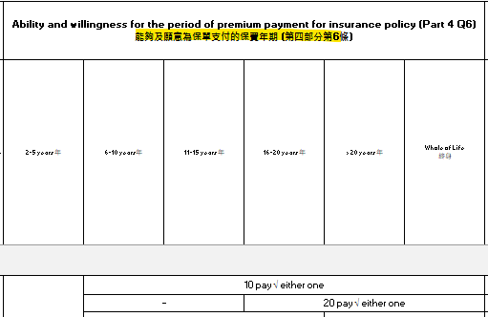
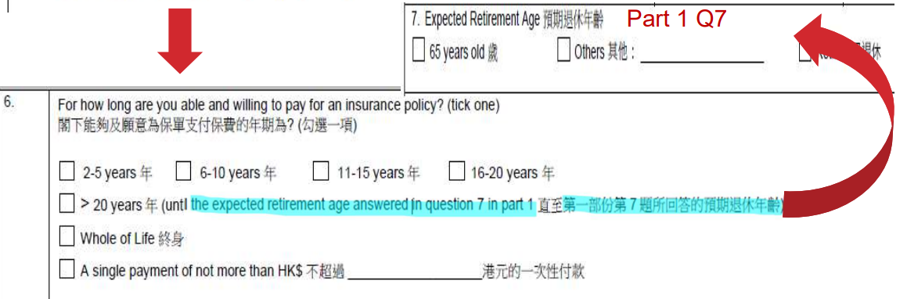
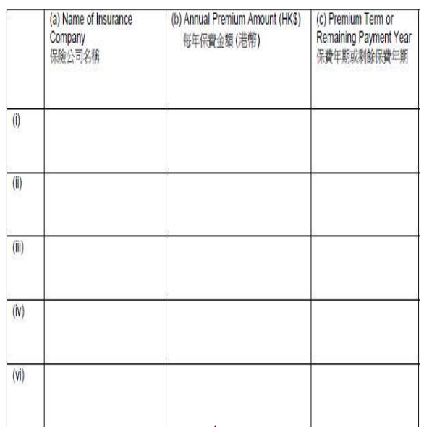

Affordability Assessment
Consider use combine approach
√

Slide 15
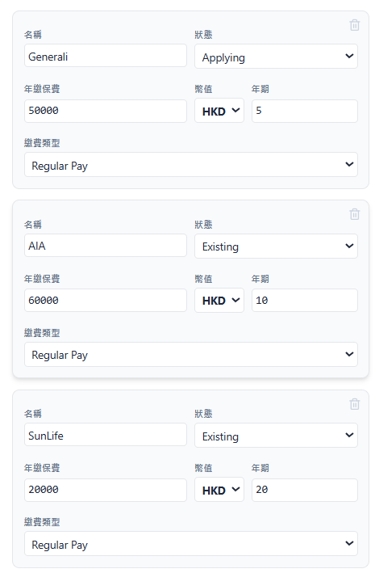
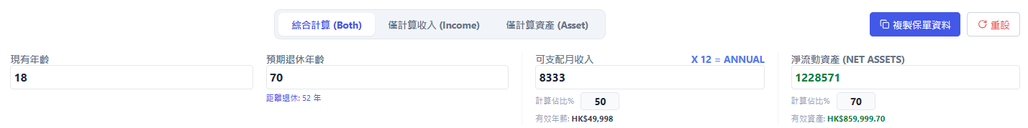
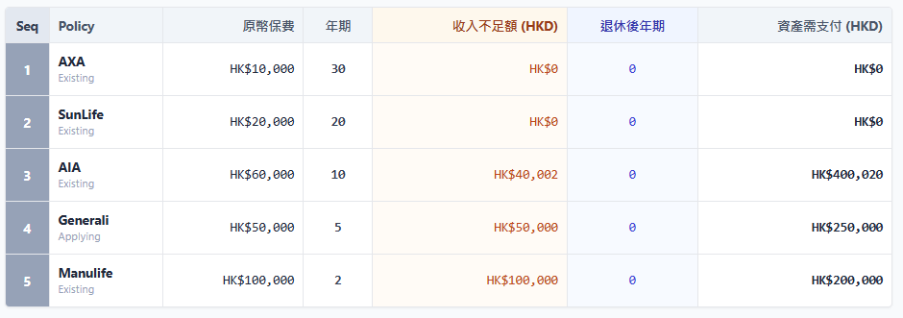
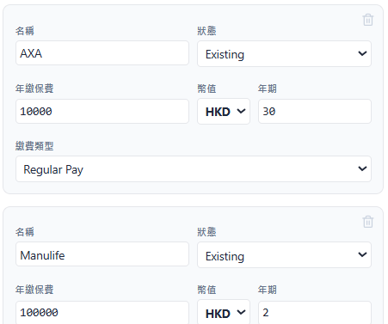
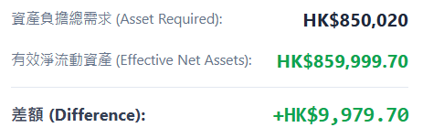

Affordability Assessment

Slide 16
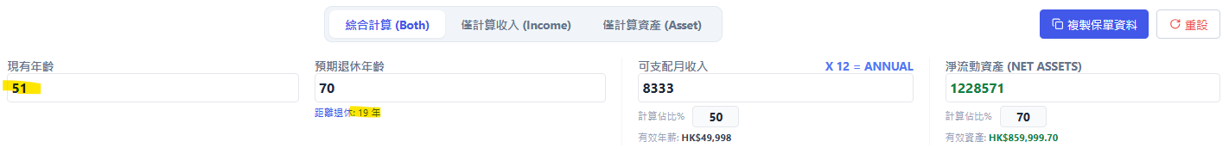
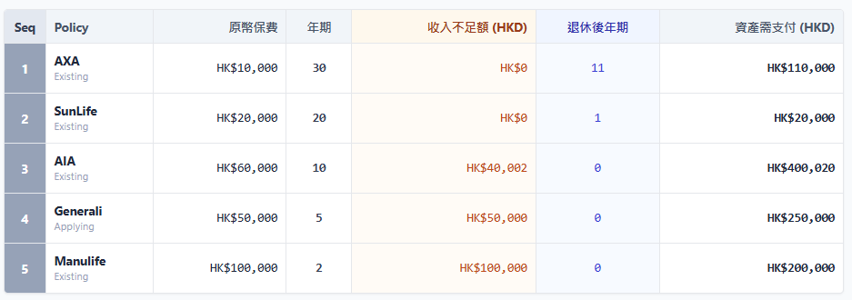
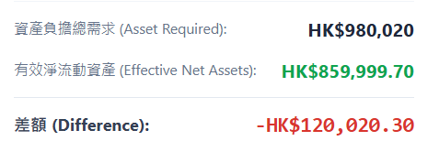

Affordability Assessment

Slide 17
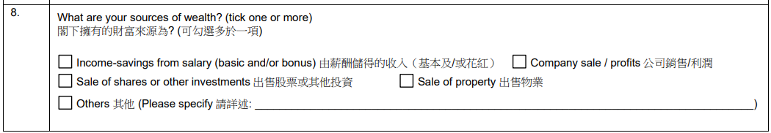
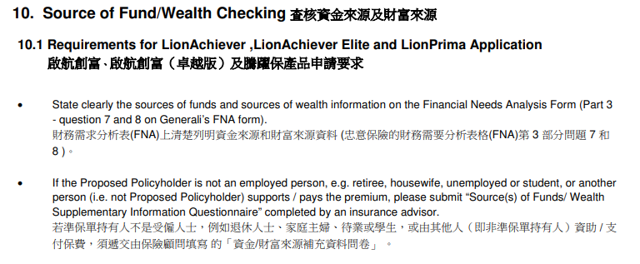



Source of Fund/Wealth Checking

Slide 18
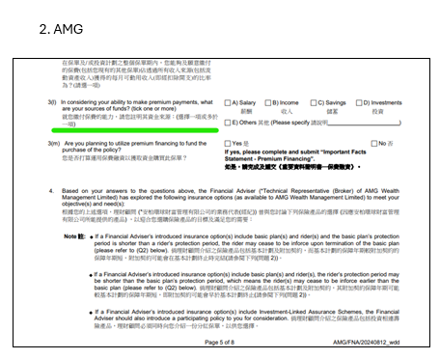
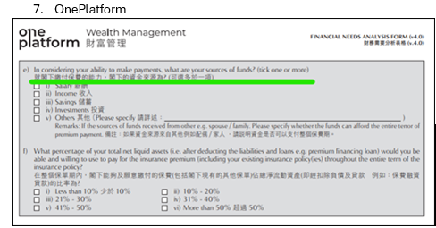
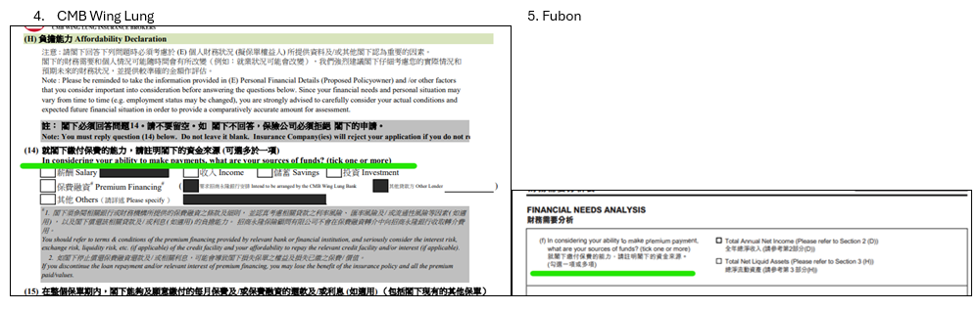
Source of Fund/Wealth Checking
Some broker’s FNAs are found to have NO SOW and/or SOF information.
If that is the case, we will obtain Supplementary Form.

Slide 19
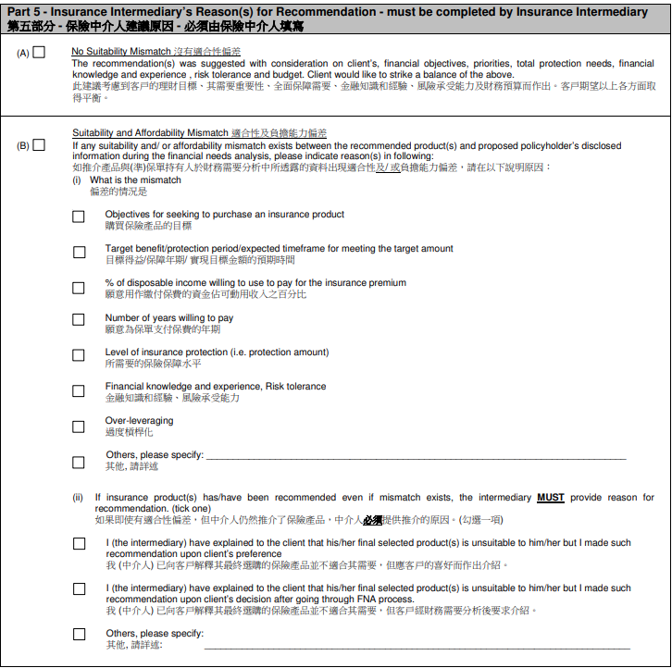
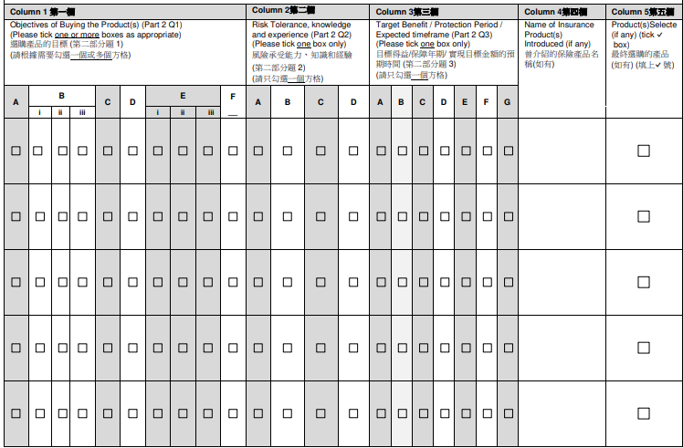
Insurance Intermediary’s Evaluation and Recommendation

Slide 20
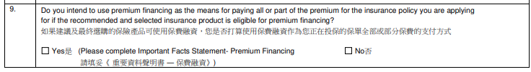
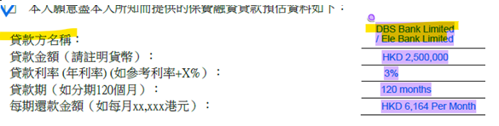
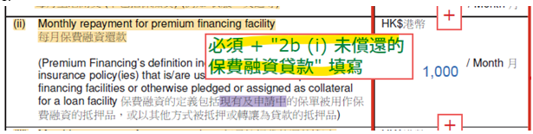
Affordability Assessment for Premium Financing

Slide 21
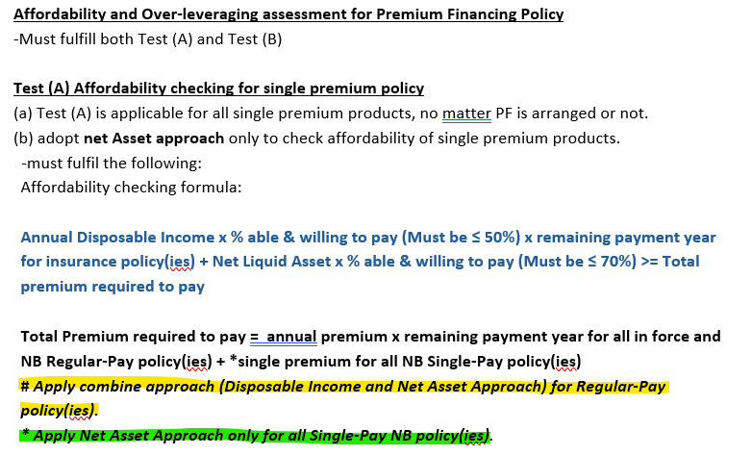
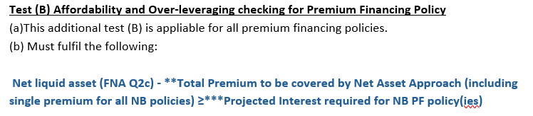
Affordability Assessment for Premium Financing

Slide 22
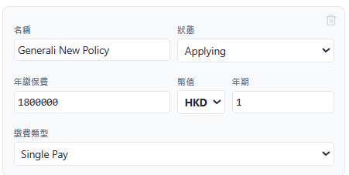









Affordability Assessment for Premium Financing

Slide 23




Affordability Assessment for Premium Financing

Slide 24






Affordability Assessment for Premium Financing

Slide 25


